Slide 1

DIGITAL TRANSFORMATION
Deepika Ghotra
Whitney Kim
Manny
Aditya
Greg
Vansh Kumar
Kunal
Savera Shah
Pearce

Slide 2
CHALLENGE:
How can governments utilize blockchain technology to ensure the integrity and transparency of public records and transactions?
What are the advantages and potential shortcomings of using generative AI to process and analyze large datasets for improving public service delivery?
What strategies can be employed to bridge the digital divide and ensure equitable access to digital services for all citizens?

Slide 3

LEVERAGE OF BLOCKCHAIN?
Governments can leverage blockchain technology to enhance the integrity and transparency of public records and transactions in several ways. Blockchain’s key features—decentralization, immutability, and transparency—make it an ideal tool for creating secure, tamper-proof systems for managing government data and ensuring accountability.

Slide 4
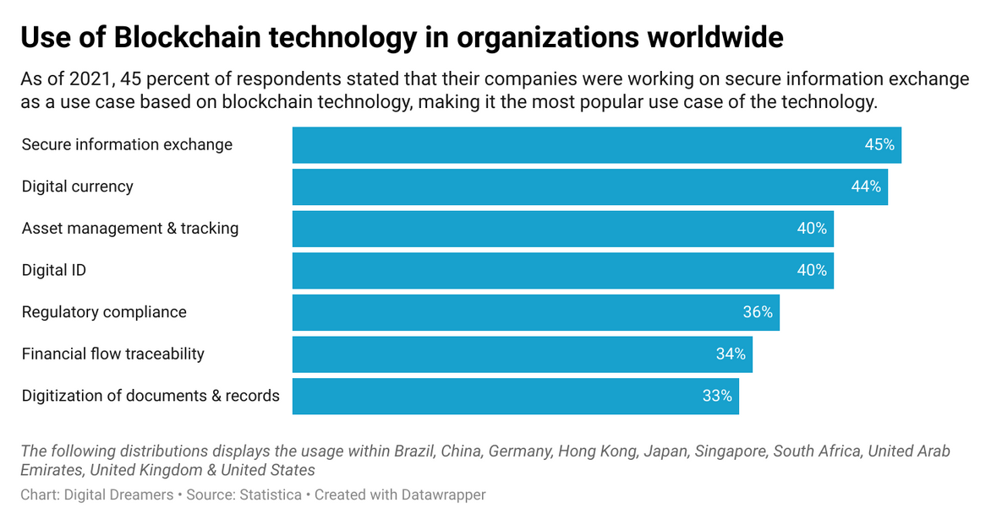

Slide 5
CHARACTERISTICS
Blockchain provides a public, immutable record of all transactions, which makes it easier for citizens to verify the integrity of government actions and public resources.
By ensuring that transactions cannot be altered after the fact, blockchain enhances accountability in government processes.
Transparancy
Accountability
Blockchain's decentralized nature and encryption make it resistant to hacking and fraud.
Blockchain can automate processes and reduce the administrative burden, improving service delivery and reducing costs.
Security
Efficiency
http://ishk.com/HumanJourney/FirstTechnologies

Slide 6
Source: Github repo for ID4D maps made with R: https://github.com/eteitelbaum/wb_data_dive
ID4D MAPS

Slide 7
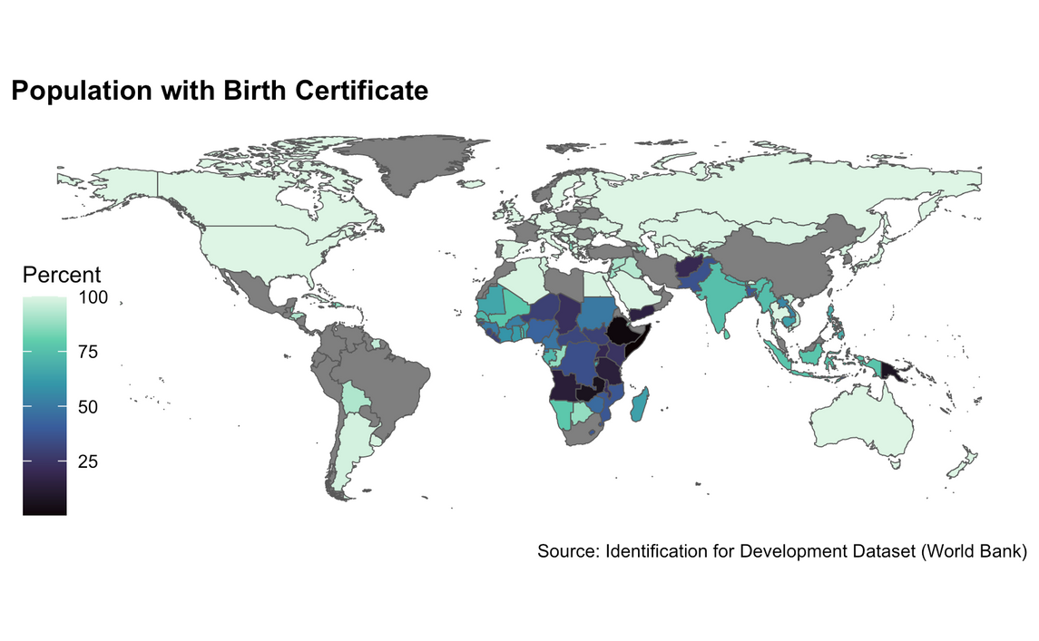
Map 1: Birth Certification % - The percentage of children under age 5 whose births were registered at the time of the survey and whose birth certificate was seen by the interviewer or whose mother or caretaker says that a birth certificate has been issued for the child.

Slide 8
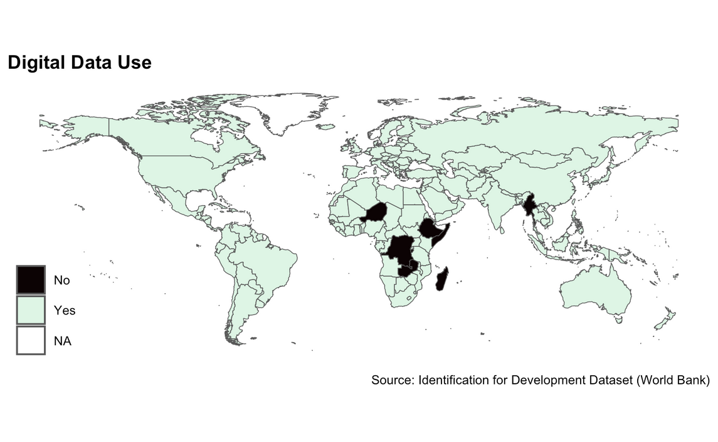
Map 2: Digital Data Use - Records are stored in a digital format, rather than in paper records or ledgers.

Slide 9
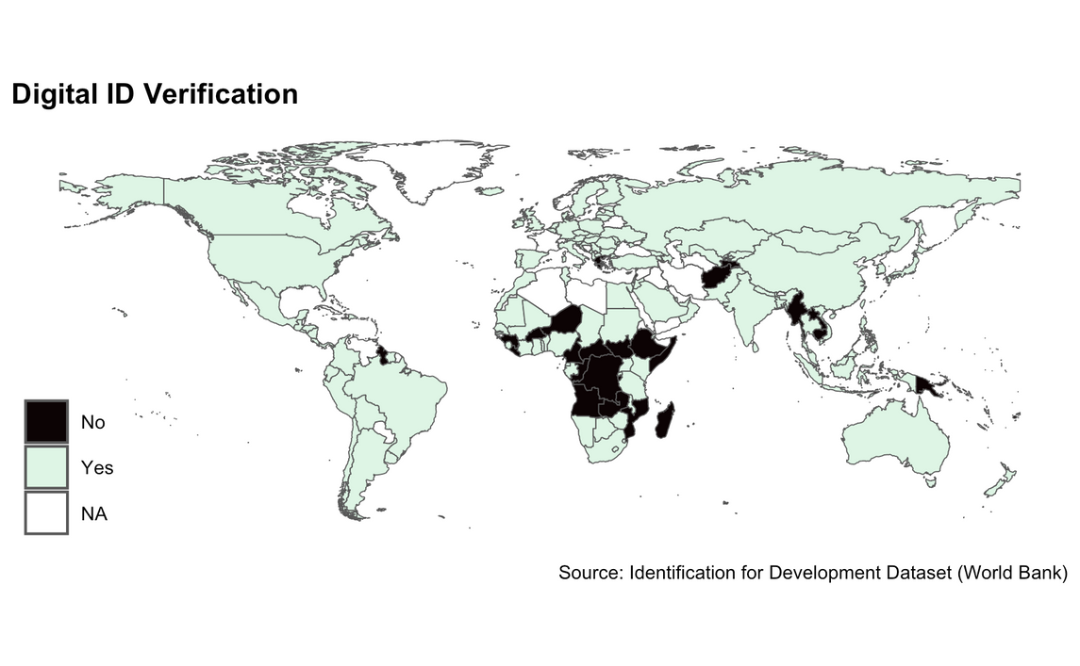
Map 3: Digital ID Verification - Identities and/or identity information (e.g., name, date of birth, etc.) can be verified or authenticated using digital—rather than manual—means in the context of in-person transactions

Slide 10
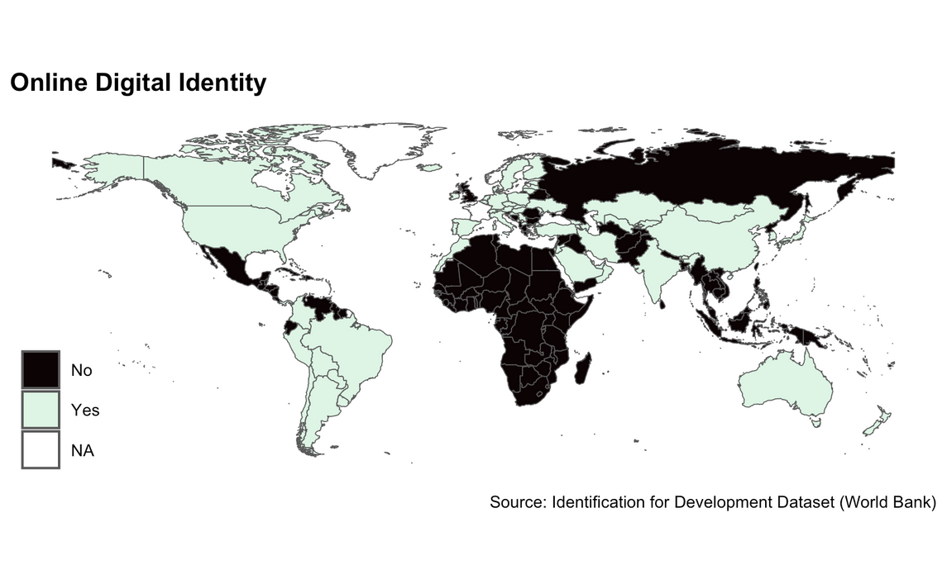
Map 4: Online Digital Identity - There is a system or systems that provide credentials that enable people to securely authenticate themselves remotely, to access online services and transactions.

Slide 11
Estonia has implemented a blockchain-based system for digital identities, enabling citizens to vote, access healthcare, and interact with government services online in a secure and transparent way. Source: (https://publicadministration.un.org/egovkb/en-us/Data-Center)
The highly populated country India’s State/UT wise Aadhaar Saturation https://uidai.gov.in/images/Aadhaar_Saturation_Report_31032024.pdf
HERE’S HOW GOVERNMENTS CAN USE IT:

Slide 12
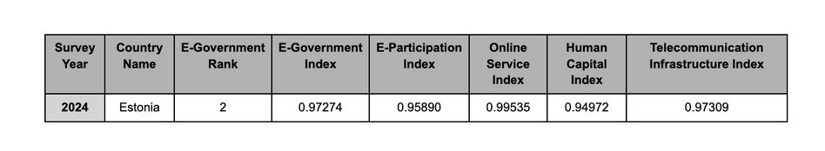
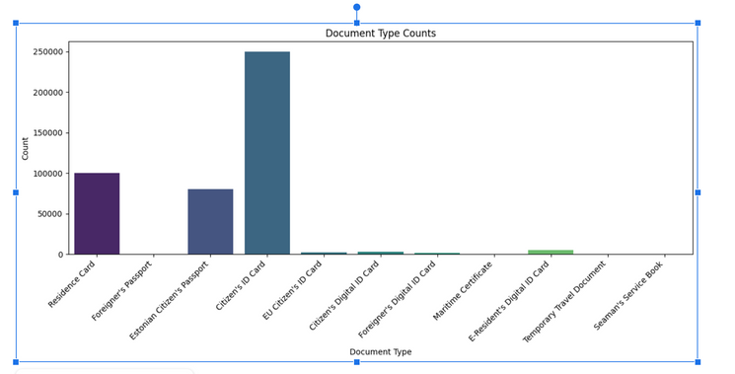
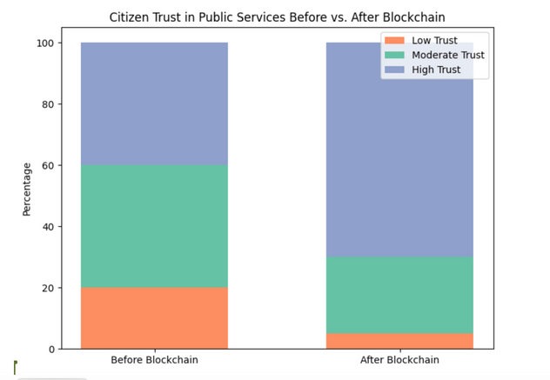

Slide 13
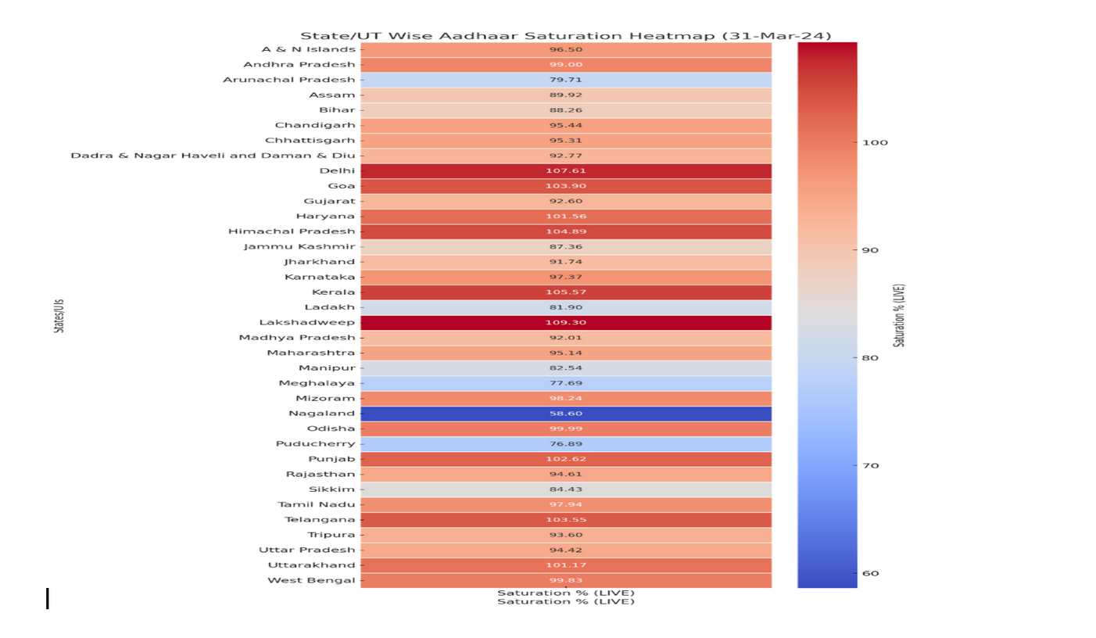
HERE’S HOW GOVERNMENTS CAN USE IT:

Slide 14

THANK YOU!

